Slide 1
Hydrogen in Australia
Martin Hablutzel, 7 May 2019
siemens.com
Unrestricted © Siemens Ltd 2019

Slide 2
Different storage technologies for different applications – hydrogen for large-scale and long-term energy storage
Duration
  Hydrogen can
  be stored
  cost-effectively
  on a large scale.
Weeks
Hydrogen & derived chemicals¹
Flow-
Batteries
Pumped
Hydro
Days
Compressed Air
Hours
Batteries²
Flywheel storage
(< 1MW Flywheel, up to 100 MW Turbines)
Technology
Minutes
Chemical
Super
capacitor
Thermal
Electrochemical
Mechanical
Electrical
Seconds
Power
1 kW
100 kW
1 MW
10 MW
100 MW
1,000 MW
¹ such as Ammonia, Methanol or others;
² Li-Ion, NaS, Lead Acid, etc.

Slide 3
“Yes my friends, I believe that water will one day be employed as fuel, that hydrogen and oxygen which constitute it, used singly or together, will furnish an inexhaustible source of heat and light, of an intensity of which coal is not capable.... When the deposits of coal are exhausted we shall heat and warm ourselves with water. Water will be the coal of the future.”
—Jules Verne, The Mysterious Island (1874-5)

Slide 4
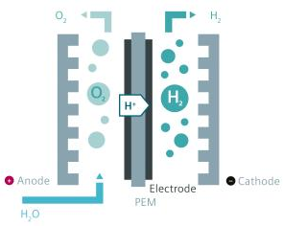
Proton exchange membrane (PEM) electrolysis – the efficient way for green hydrogen
How does PEM electrolysis work
  Electrodes are attached on both sides of the proton exchange membrane
  Proton exchange membrane is the electrolyte
  Proton exchange membrane acts as separator to prevent mixing
  of the gas products
1973
J. H. Russell released his works to PEM electrolysis and the high potential
Advantages of PEM electrolysis
  High power density
  Extended dynamic operation range and direct coupling to renewables (rapid response)
  High efficiency
  High gas purities
  Low maintenance needs

Slide 5
Hydrogen from renewables enables large scale long term storage and sector coupling.
Variable electricity generation
Grid
integration
Conversion/ storage
Applications
Photovoltaic
Industry (eg Ammonia, Synthetic Fuels)
Mobility
Grid
Stabilisation
PEM electrolysis
H₂ storage and distribution
Electricity System Resilience
Gas Network
Wind Power
Export

Slide 6

There are different applications for green hydrogen in Industry, Mobility and Energy
Segment | Application | Description
Industry | Ammonia production | Onsite H₂ production from renewable energy replacing Steam methane reforming (SMR) or coal gasification or substitute trailers for industrial processes like ammonia production, petroleum refinement, metal production, glass industry, specialty refineries, food & beverage, chemical industry etc.
 | Petroleum refinement
 | Metal production
 | Other industries
Mobility | Alternative fuel | Using hydrogen as fuel for fuel cell vehicles (FCV) for long distance in parallel to BEV for short to medium distance; Reduction of CO₂ footprint for individual, public and commercial transport
 | Green fuels | Using hydrogen to create green fuels (hydrocarbon mixtures) substituting or adding to fossil sources of power (e.g., like 1st/2nd gen biofuels being added to gasoline)
Energy | Hydrogen blending (gas grid) | Substitute up to 10% Methane/NG in the gas-grid by feeding in hydrogen
 | Re-electrification | Provide energy by re-electrification of green H₂ (supplied by trailer or produced on-site) in remote/off-grid areas and/or substitution of diesel generators and batteries
Add on | Grid services | Using electrolysis as load to provide primary and secondary control power
 | Energy storage | Absorb peak production by storing renewable energy as H₂ instead of curtailment
 | Energy export | Export renewable energy with liquid H₂ ; Ammonia or other hydrogen carrier (e.g. LOHC, LH2)
+

Slide 7
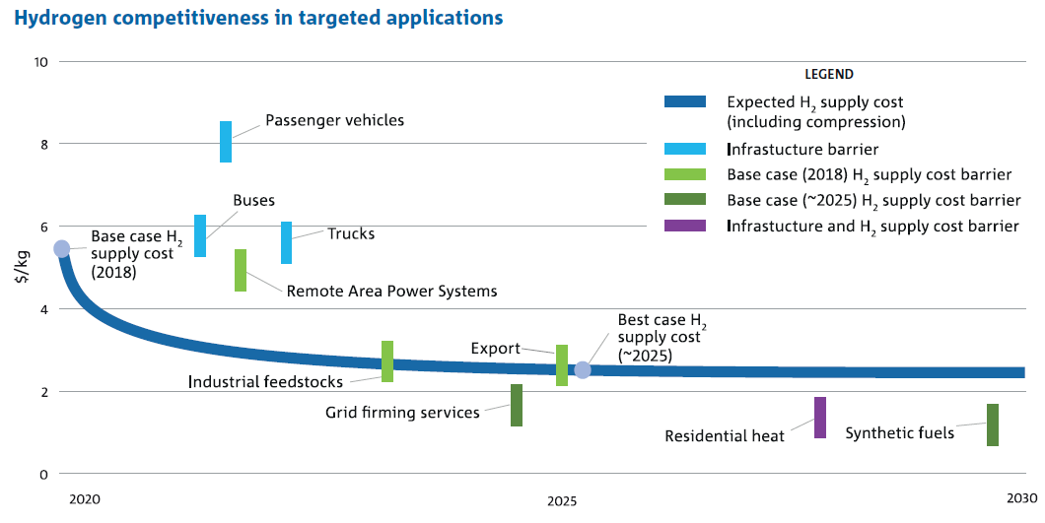
Hydrogen business case depends on the application.
Source: Australian National Hydrogen Roadmap, CSIRO https://www.csiro.au/en/Do-business/Futures/Reports/Hydrogen-Roadmap August 2018.

Slide 8
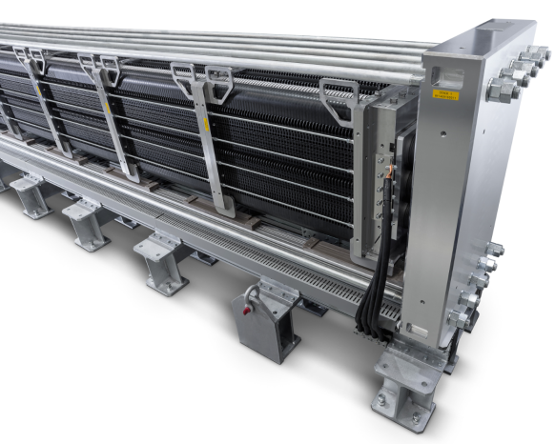
Silyzer 200
High-pressure efficiency in the megawatt range
5 MW
60 kWh
World’s largest operating PEM electrolyzer system in Hamburg, Germany
Specific energy consumption for 1 kg hydrogen
20 kg
1.25 MW
Hydrogen production per hour
Rated stack capacity

Slide 9
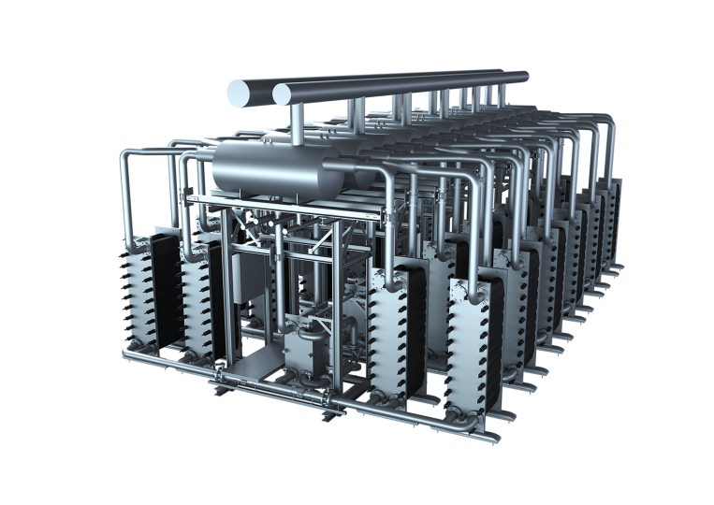
Silyzer 300 – the next paradigm in PEM electrolysis
17.5 MW
per full Module Array
(24 modules)
75 %
System efficiency
(higher heating value)
24 modules
to build a
full Module Array
340 kg
hydrogen per hour
per full Module Array
(24 modules)
Silyzer 300 – Module Array (24 modules)

Slide 10
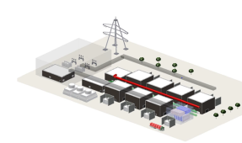
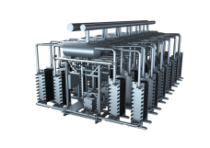

Technology scales up by factor 10 every 4-5 years.
Lower costs bring new applications into play.
Reduction of H₂ production cost ($/kg H₂)
>2030
>1,000 MW
2018 – 2023+
First investigations
in cooperation with
chemical industry
Next generation
Silyzer >100 MW
2015 – 2018
Under development
Silyzer 300
>10 MW class
2011 – 2015
Released 2018
Silyzer 200
1 MW class
Silyzer 100
100 – 300 kW
Commercial product
Lab-scale
Notes:
Development focus:
Large scale, industrial hydrogen plant concepts
Lowest specific cost
Fleet data digitalization

Slide 11
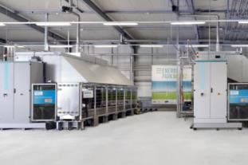

Energiepark Mainz
World’s largest PEM electrolysis facility in 2015
Facts & figures
Use cases
Customer: Energiepark Mainz (JV of Linde and Mainzer Stadtwerke)
Country: Germany
Installed: 2015
Product: Silyzer 200
Green hydrogen is fed into the local natural gas grid.
Delivery to surrounding industrial companies.
Hydrogen for regional filling stations.
3.75 MW
rated power / 6.0 MW peak power (limited in time) based on three Silyzer 200
Challenge
Installation of world’s first PEM electrolysis plant in the multiple megawatt range
Provision of balancing energy
High degree of automation
Solutions
Installation of three SILYZER 200 with a maximum power consumption of 6 MW
Highly dynamic power consumption
State-of-the-art process control technology based on SIMATIC PCS 7
Hydrogen processing, condensing, and storage (provided by Linde)

Slide 12
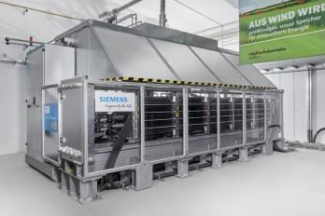
South Australia – Australian Gas Infrastructure Group
Largest PEM electrolyser in Australia
Facts & figures
Use cases
Customer: AGIG
Country: Australia
Installed: under delivery
Product: Silyzer 200
Green hydrogen is fed into the local gas network.
Future plans to add refueling capability.
1.25 MW
rated power based on Silyzer 200
Challenge
Installation and integration into the local gas network
Remote control of electrolyser to integrate with local microgrid and solar power generation
Potential for future addition of refueling facility and/or tube trailer
Solutions
Operation of a SILYZER 200
Highly dynamic power consumption
State-of-the-art process control technology based on SIMATIC PCS 7

Slide 13
Hydrogen industry development
Sustainable pipeline of scale projects domestically will build industry capability and accelerate commercialisation for export.
Very large scale commercial export projects
Investment projects
“double-digit”
Example applications:
Energy grid stabilisation
RAPS
Mobility (eg cars/buses)
Gas grid injection
Industrial
Project Scale
Early export projects
>100MW
Tonsley, ATCO, Jemena
2018
2020
2022
2025+
Subsidy per MW*
~$2.5m per MW
>5$m per MW
<$1m per MW
~$0m per MW**
*Subsidy expressed as total project costs / MW electrolyser installed
** Low-cost finance and carbon pricing impact may be considered as ‘subsidies’

Slide 14
Contact page
Martin Hablutzel
Head of Strategy
885 Mountain Highway
Bayswater VIC 3153
Mobile: +61 (0)408 383 891
E-Mail: martin.hablutzel@siemens.com
siemens.com

